Slide 1

SAMSUNG SALES PERFORMANCE & FORECAST REPORT
This report presents a comprehensive analysis of Samsung’s sales performance across products, regions, categories, channels, and time, along with a forward-looking revenue forecast to guide strategic growth.

Slide 2
OVERVIEW
Key Metrics:
Total Quantity Sold: 10,733 units
Total Revenue: $6,705,162.94
Forecast Insight:
Projected 2025 Revenue: $5,827,406.92
Key Takeaways:
Premium products (Foldables & Ultra models) are the primary revenue drivers.
Europe and Asia dominate regional performance.
Sales exhibit strong seasonal patterns.
Revenue is stable year-over-year, indicating a mature market.
Forecast suggests moderate growth with opportunities for strategic expansion.

Slide 3
BUSINESS OBJECTIVE
Business Problem and Questions to ask #How can the company increase smartphone sales and revenue across regions, products, and customer segments? #This dataset can help the business understand: #Which products sell the most? #Which regions generate the most revenue? #Which customer segments buy more? #Whether discounts increase sales? #Which sales channels perform best? #Whether returns or low ratings affect revenue?

Slide 4
PERFORMANCE OVERVIEW
Product Performance
Top-performing products are dominated by Galaxy Z Fold and Galaxy S Ultra series.
Premium pricing strategy is highly effective.
Implication: Revenue growth is currently driven by high-value devices rather than volume alone.

Slide 5
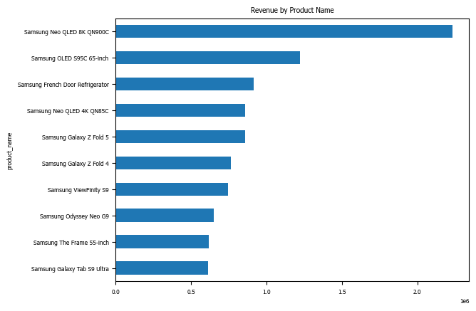

Slide 6
REGIONAL PERFORMANCE
Europe ($2.39M) and Asia ($1.90M) are the strongest markets.
Emerging regions (Africa, South America) show growth potential.
Implication: Samsung has strong market penetration in developed regions but untapped potential in emerging markets.

Slide 7
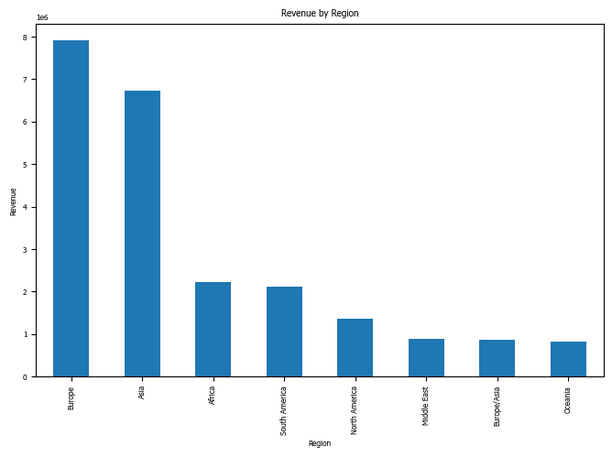

Slide 8
CATEGORY PERFORMANCE
Smart TVs lead revenue ($5.56M), followed by Galaxy S and Galaxy Z.
Implication: Samsung benefits from a diversified ecosystem, enabling cross-selling opportunities.

Slide 9
SALES CHANNELS
Revenue is evenly distributed across all channels.
Implication: A strong omnichannel strategy reduces dependency risk and stabilizes revenue streams.

Slide 10
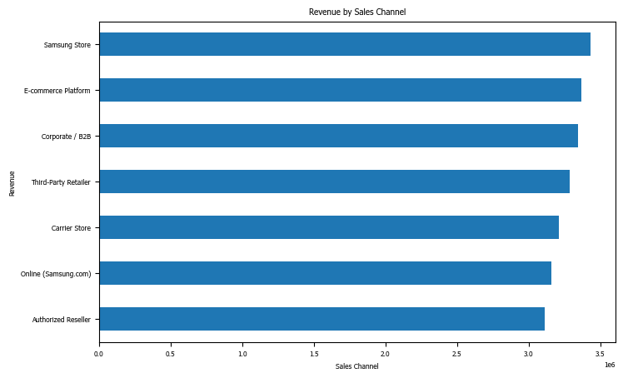

Slide 11
MONTHLY TRENDS
Peak Months: October, January, December
Lowest Month: February
Implication: Revenue is seasonally driven, with strong Q4 performance.

Slide 12
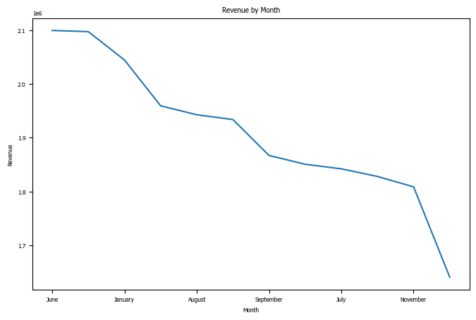

Slide 13
YEARLY TRENDS
Revenue remains stable between $5.59M – $5.87M
Slight dip observed in 2024
Implication: Samsung operates in a mature and competitive market, requiring innovation for growth.

Slide 14
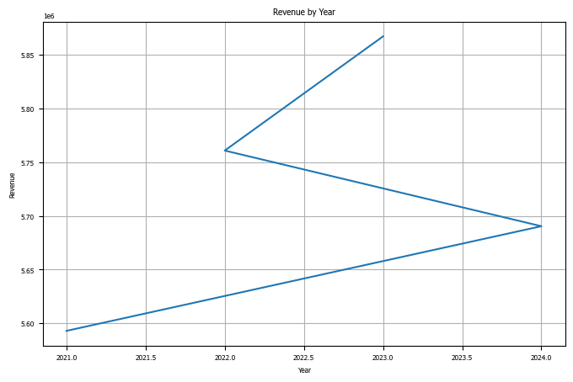

Slide 15
FORECASTING ANALYSIS
Model Used:
Linear Regression (trend-based forecasting)
Prophet (time-series forecasting with seasonality)
Both models produced consistent results, increasing confidence in projections.
2025 Revenue Forecast
Projected Revenue: $5,827,406.92
Interpretation:
Slight decrease compared to 2023 peak (~$5.87M)
Indicates stagnation rather than strong growth

Slide 16
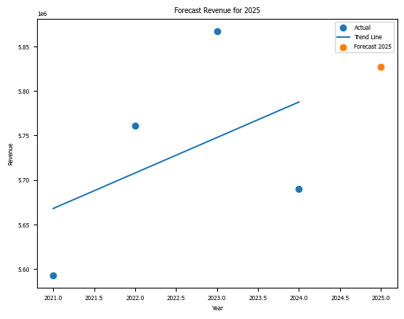

Slide 17
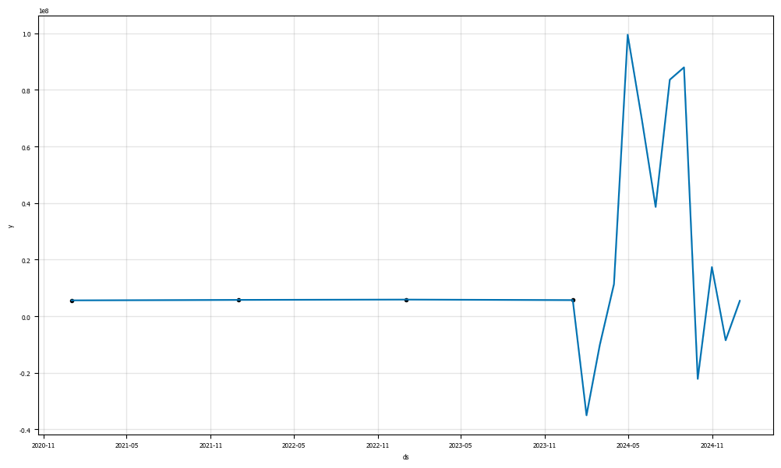

Slide 18
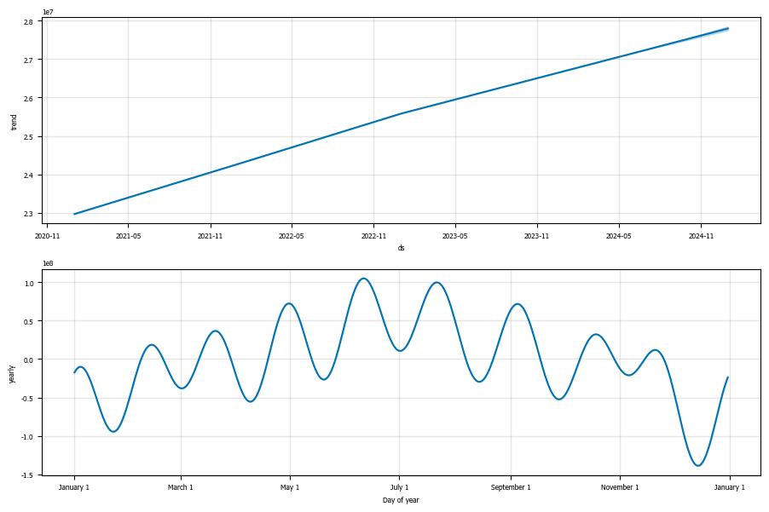

Slide 19
FORECAST INSIGHTS & BUSINESS IMPLICATIONS
Market Plateau Risk
The forecast suggests:
Revenue growth is flattening
Market may be approaching saturation
Risk: Without intervention, revenue may stagnate or decline.
Dependence on Premium Products
High reliance on flagship devices
Risk: Economic downturns could reduce demand for premium products.
Seasonal Dependence
Strong reliance on Q4 performance
Risk: Revenue volatility if peak season underperforms.

Slide 20
STRATEGIC GROWTH OPPORTUNITIES
Expand Mid-Range Product Strategy
Introduce competitively priced devices
Target price-sensitive markets
Expected Impact: Increase volume sales and market share
Accelerate Growth in Emerging Markets
Focus on Africa and South America
Localize pricing and marketing
Expected Impact: Unlock new revenue streams
Maximize Peak Season Revenue
Launch flagship devices before Q4
Increase marketing spend in high-performing months
Expected Impact: Boost seasonal revenue spikes

Slide 21
STRATEGIC GROWTH OPPORTUNITIES II
Strengthen Product Ecosystem
Bundle smartphones with TVs, tablets, and accessories
Expected Impact: Increase average transaction value
Enhance Customer Retention
Improve product quality and ratings
Reduce return rates
Expected Impact: Protect and grow long-term revenue
Optimize Pricing & Discounts
Use targeted, data-driven discounts
Avoid excessive price reductions
Expected Impact: Maintain profitability while driving demand

Slide 22
STRATEGIC RECOMMENDATIONS
Executive Summary
To increase revenue beyond the forecasted plateau, Samsung should:
Diversify beyond premium products
Expand aggressively into emerging markets
Leverage seasonality more effectively
Strengthen ecosystem-based sales
Maintain a balanced omnichannel strategy

Slide 23
Thank you!!!

